Slide 1
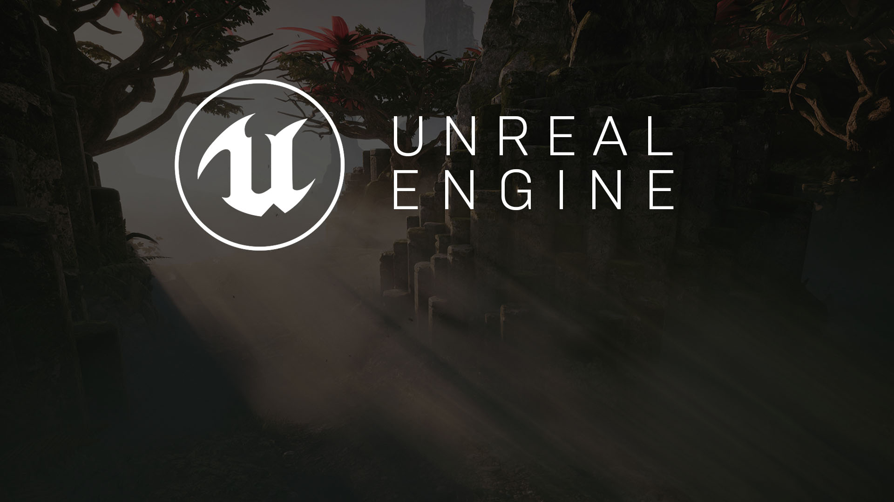
hour 2, lecture 1
Anatomy of a Project:
Available Resources and Project Folders

Slide 2

Introduction
Unreal Engine 4 is a deep and rich application that can be used to create anything from 2D indie games to 3D AAA titles to interactive applications, architectural visualizations, and VR experiences.
UE4 can create content for various platforms ranging from PC and consoles to mobile and web-based HTML.
The UE4 Editor takes many of the complicated processes of development and puts them into an easy-to-use developer’s application environment.
This lecture introduces you to the anatomy of a project and available resources.

Slide 3
Lecture Goals and Outcomes
Goals
Outcomes
The goals of this lecture are to
Learn about available resources
Learn the basic anatomy of a typical UE4 Blueprint project
By the end of this lecture you will be able to
Download a sample project
Explain the basic anatomy of a typical project

Slide 4
Available Resources
Epic Games Launcher

Slide 5

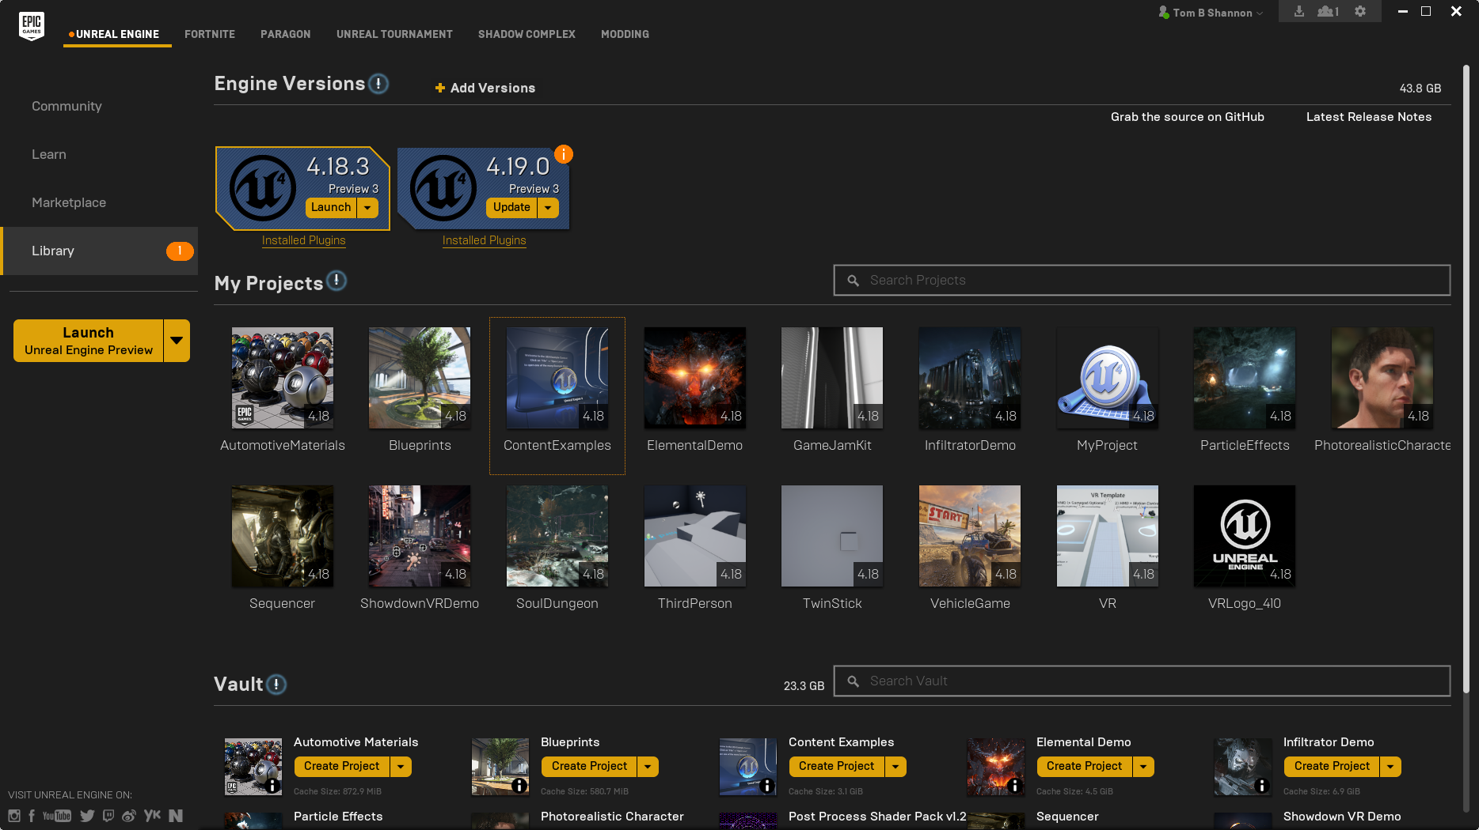
Epic Games Launcher
There are many resources available to users just starting out with UE4. The Epic Games Launcher manages your projects and gives you access to sample projects and the Marketplace, where you can purchase content. It also provides web links to the Epic community.

Slide 6
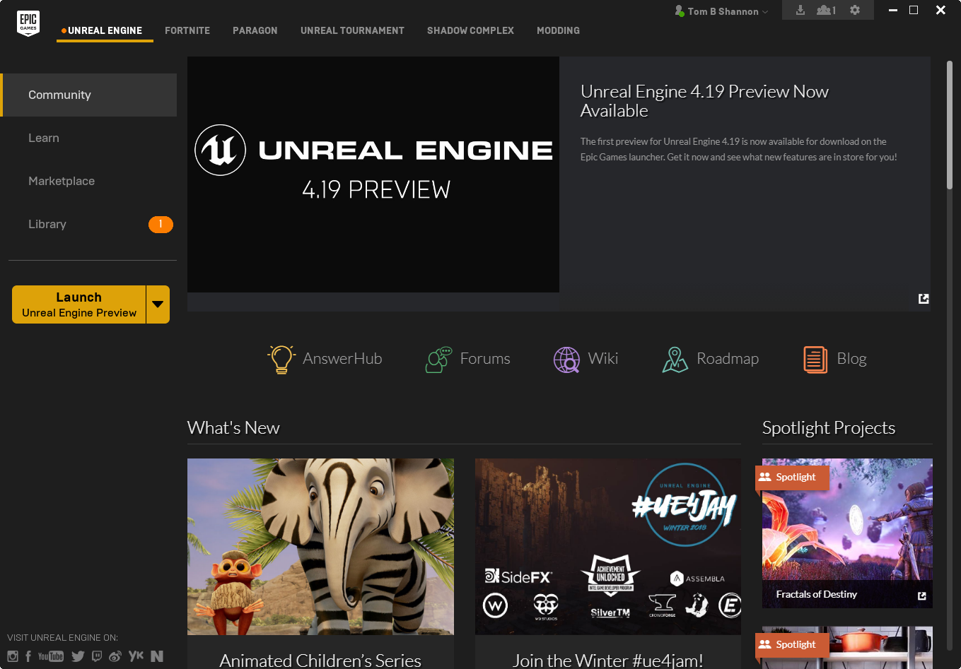
Epic Games Launcher: Community
The Epic Games Launcher contains a Community section that offers news and project spotlights as well as links to forums, blogs, and the engine development roadmap.

Slide 7
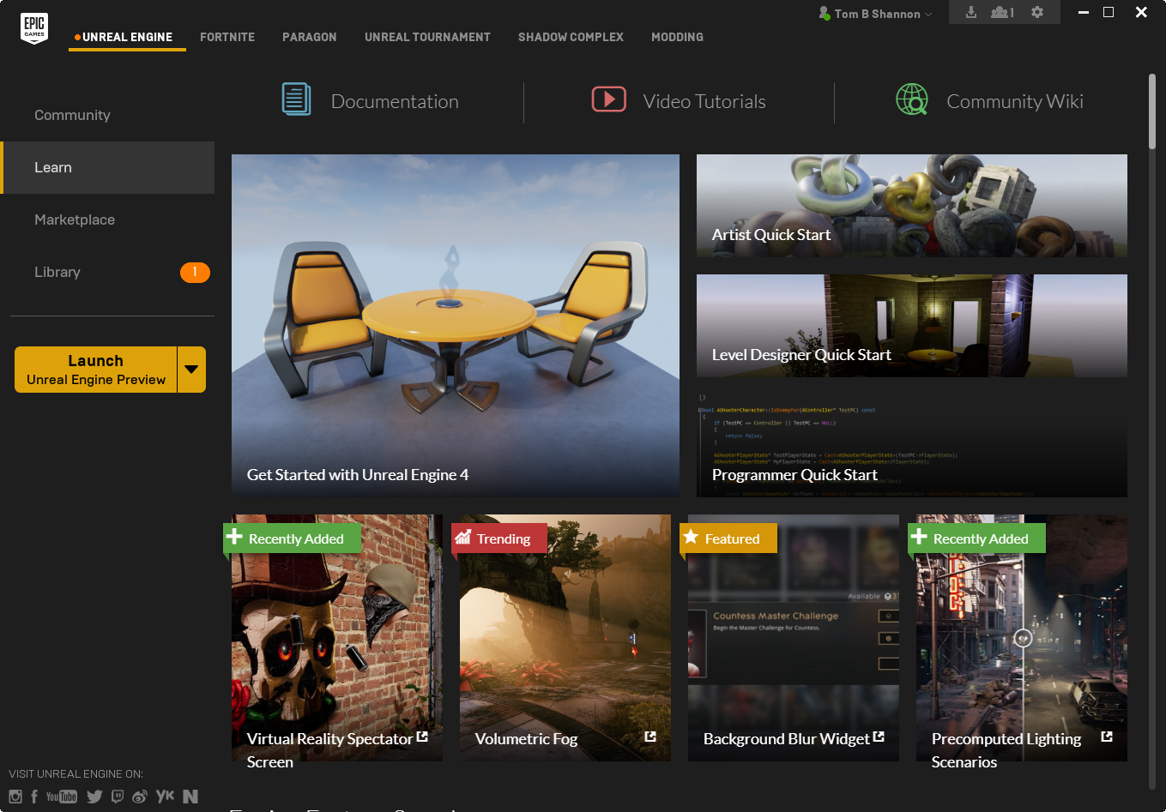
Epic Games Launcher: Learn
The Learn section in the Launcher provides links to
Online documentation
Video tutorials
Projects from Epic Games and the Unreal community

Slide 8
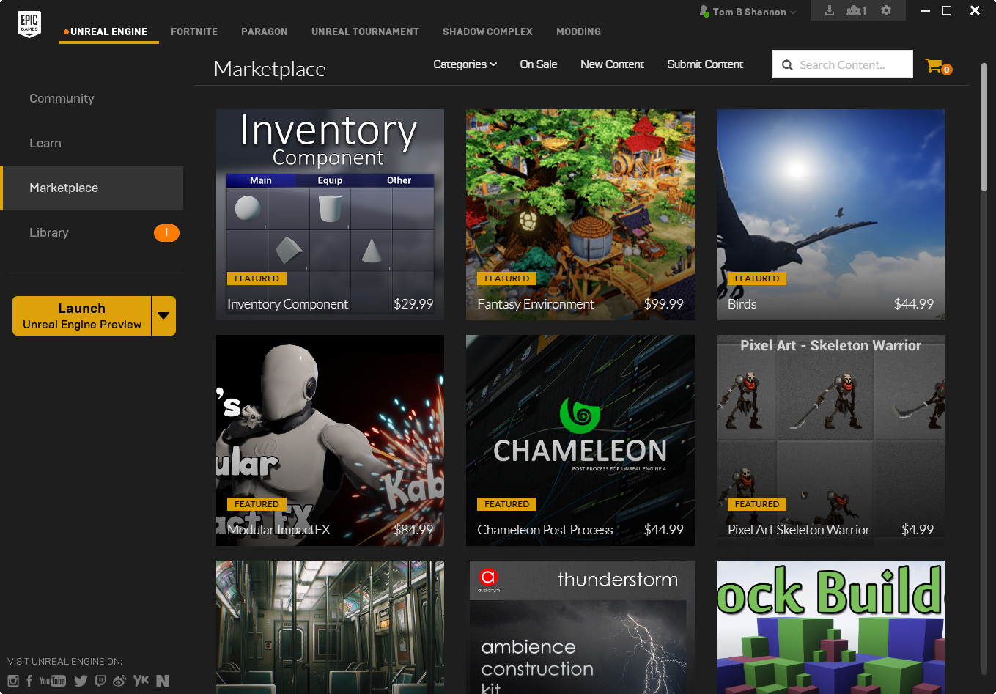
Epic Games Launcher: Marketplace
The Marketplace has content for sale organized in categories ranging from art and sound to scripting and FX.

Slide 9
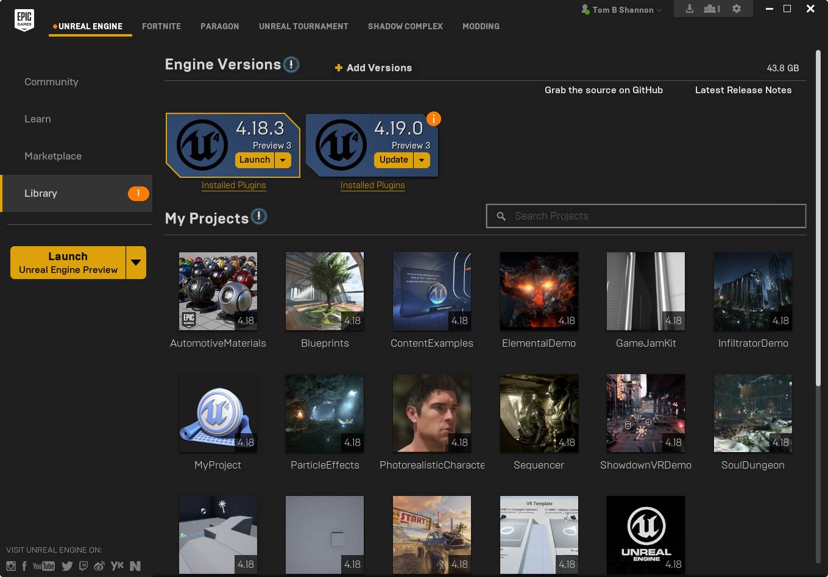
Epic Games Launcher: Library
The Library section keeps track of
Engine versions you have installed
Projects you have created
Content you have purchased from the Marketplace or sample projects you have downloaded

Slide 10
The Anatomy of a project
Project Folders

Slide 11
Exercise:
What happens when you create a new project?
Once a project is created, the Editor copies a collection of default folders and files into the project folder.
Create a new blank project with starter content.
Use the Epic Launcher to open the project file.
Notes:
While initial project sizes are small, the more content that is added to a project and process, such as auto backup, the more quickly the project size increases. Expecting students to submit uncompiled projects for grading is unrealistic. It typically is best to have students submit executables or video documentation of the project running.

Slide 12
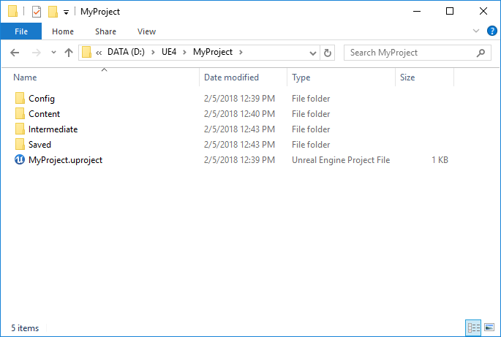
Project File Structure
In the project folder, you will find the following subfolders:
Config
Content
Intermediate
Saved
You will also find a .uproject file that defines the parameters of the project, such as what version of UE4 to use to open the project.

Slide 13
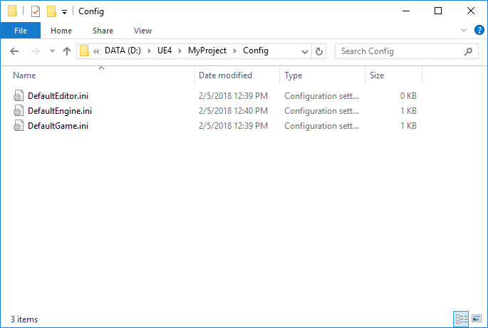
Config Folder
The Config folder contains default .ini files that are used to store project settings.

Slide 14
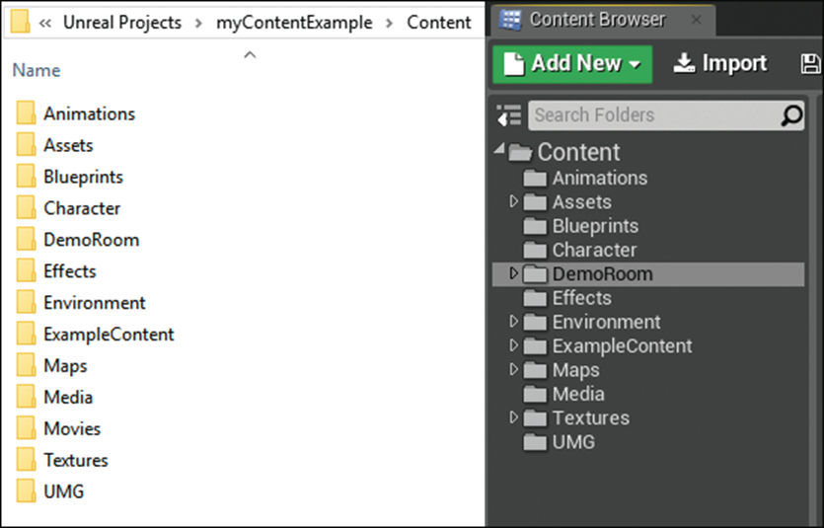
Content Folder
The Content folder stores all the assets in the project that are either imported, migrated, or created directly in the Editor.
The Content folder typically contains two file types:
When a file is imported, it is saved as a .uasset file regardless of the asset type.
When a map is created and saved, it is stored as a .umap file.

Slide 15
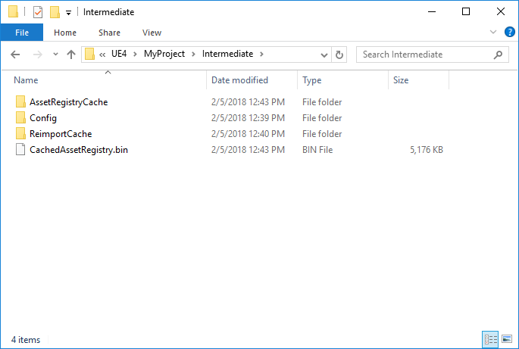
Intermediate Folder
The Intermediate folder stores the project’s working .ini setting and preference files, along with a CachedAssetRegistry.bin file.
This folder is generated at runtime and contains temporary data that is required to make working in the Editor faster.

Slide 16
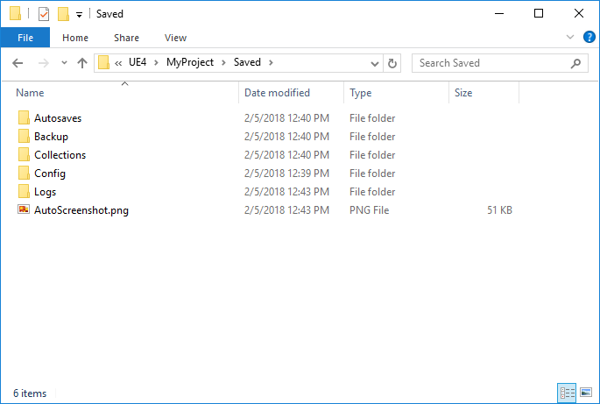
Saved Folder
The Saved folder stores files generated by the engine at runtime.
These include autosave and backup files as well as screenshots, logs, and asset collections.
The Config folder here contains temporary .ini files that are used to store project settings.

